Slide 1
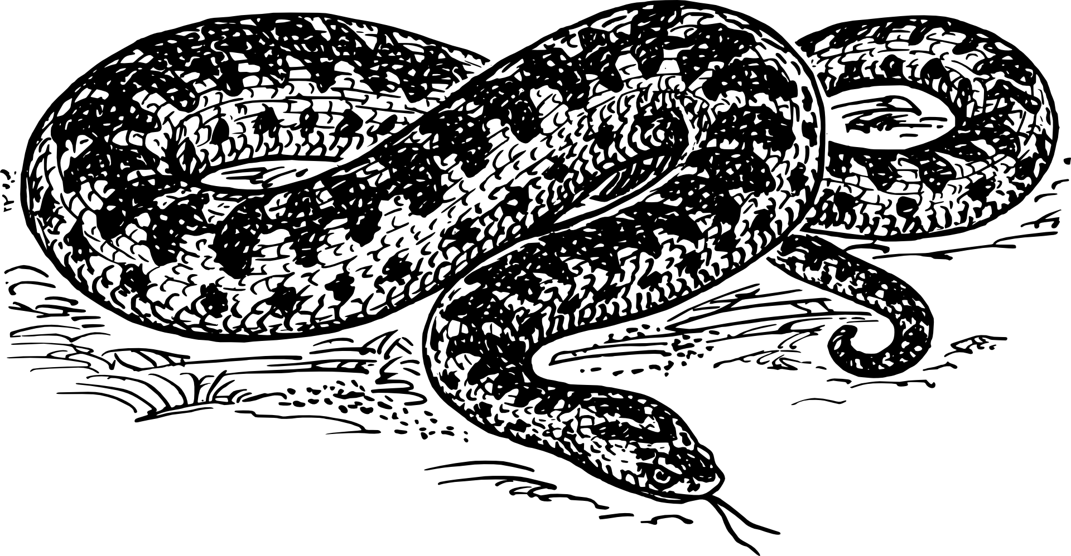
Python Day Intermediate Workshop
WiFi Network: Guest | No Password
Please open https://repl.it and http://bit.ly/scpdi

Slide 2
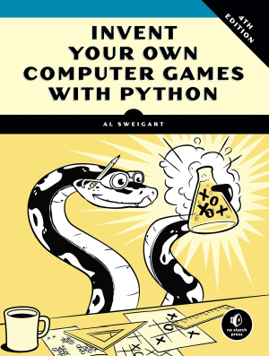
Python Day – Intermediate Workshop
Based on “Invent Your Own Computer Games with Python” – Chapter 13
Get the full book (or read it free online) at https://inventwithpython.com/invent4thed

Slide 3


Slide 4
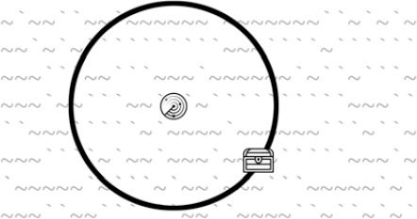
The Treasure Hunt

Slide 5
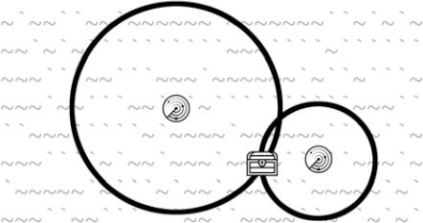
The Treasure Hunt

Slide 6
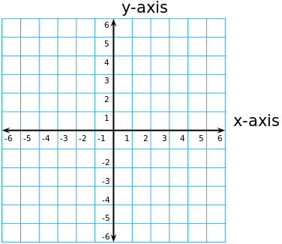
Concept: Cartesian Coordinates

Slide 7
Concept: Cartesian Coordinates

Slide 8
Concept: Lists
In Python a list is a variable that can hold
multiple other variables... including other lists.
x = [] # empty list
y = [ "potato" , 78 , "hut" , "hike" ]
z = [ [ 1 , 2 ] , ["apple" , "orange"] ]
Lists start counting at 0
y[0]’s value is “potato”
z[1][0]’s value is “apple”

Slide 9
# Sonar Treasure Hunt
import random
import sys
import math
def getNewBoard():
# Create a new 60x15 board data structure.
board = []
for x in range(60): # The main list is a list of 60 lists.
board.append([])
for y in range(15):
# Each list in the main list has 15 single-character strings.
# Use different characters for the ocean to make it more readable.
if random.randint(0, 1) == 0:
board[x].append('~')
else:
board[x].append('`')
return board
# try a line that shows the list we just created

Slide 10

The Raw Ocean
print(getNewBoard())

Slide 11
def drawBoard(board):
# Draw the board data structure.
tensDigitsLine = ' ' # Initial space for the numbers down the left side of the board
for i in range(1, 6):
tensDigitsLine += (' ' * 9) + str(i)
# Print the numbers across the top of the board.
print(tensDigitsLine)
print(' ' + ('0123456789' * 6))
print()
# Print each of the 15 rows.
for row in range(15):
# Single-digit numbers need to be padded with an extra space.
if row < 10:
extraSpace = ' '
else:
extraSpace = ''
# Create the string for this row on the board.
boardRow = ''
for column in range(60):
boardRow += board[column][row]
print('%s%s %s %s' % (extraSpace, row, boardRow, row))
# Print the numbers across the bottom of the board.
print()
print(' ' + ('0123456789' * 6))
print(tensDigitsLine)
# How could you print the game board?

Slide 12
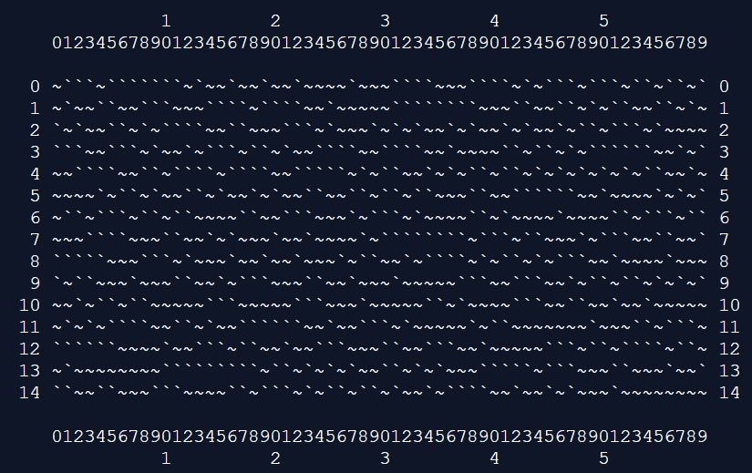
The Formatted Ocean
board = getNewBoard()
print(drawBoard(board))

Slide 13
def getRandomChests(numChests):
# Create a list of chest data structures
# (two-item lists of x, y int coordinates).
chests = []
while len(chests) < numChests:
newChest = [random.randint(0, 59), random.randint(0, 14)]
if newChest not in chests:
# Make sure a chest is not already here.
chests.append(newChest)
return chests

Slide 14
Show the Chests
print(getRandomChests(3))

Slide 15

Show the Chests
print(getRandomChests(3))

Slide 16
def isOnBoard(x, y):
# Return True if the coordinates are on the board; otherwise, return False.
return x >= 0 and x <= 59 and y >= 0 and y <= 14

Slide 17
Concept: Pythagorean Theorem
A² + B² = C²
4² + 3² = C²
B
16 + 9 = 25
4² + 3² = 5²
A
C

Slide 18
def makeMove(board, chests, x, y):
smallestDistance = 100 # Any chest will be closer than 100.
for cx, cy in chests:
distance = math.sqrt((cx - x) * (cx - x) + (cy - y) * (cy - y))
if distance < smallestDistance: # We want the closest treasure chest.
smallestDistance = distance
smallestDistance = round(smallestDistance)
if smallestDistance == 0:
# xy is directly on a treasure chest!
chests.remove([x, y])
return 'You have found a sunken treasure chest!'
else:
if smallestDistance < 10:
board[x][y] = str(smallestDistance)
return 'Treasure detected at a distance of %s from the sonar device.' % (smallestDistance)
else:
board[x][y] = 'X'
return 'Sonar did not detect anything. All treasure chests out of range.'

Slide 19
def enterPlayerMove(previousMoves):
# Let the player enter their move. Return a two-item list of int xy coordinates.
print('Where do you want to drop the next sonar device? (0-59 0-14) (or type quit)')
while True:
move = input()
if move.lower() == 'quit':
print('Thanks for playing!')
sys.exit()
move = move.split()
if len(move) == 2 and move[0].isdigit() and move[1].isdigit() and isOnBoard(int(move[0]), int(move[1])):
if [int(move[0]), int(move[1])] in previousMoves:
print('You already moved there.')
continue
return [int(move[0]), int(move[1])]
print('Enter a number from 0 to 59, a space, then a number from 0 to 14.')

Slide 20
def showInstructions():
print('''Instructions:
You are the captain of the Simon, a treasure-hunting ship. Your current mission
is to use sonar devices to find three sunken treasure chests at the bottom of
the ocean. But you only have cheap sonar that finds distance, not direction.
Enter the coordinates to drop a sonar device. The ocean map will be marked with
how far away the nearest chest is, or an X if it is beyond the sonar device's
range. For example, the C marks are where chests are. The sonar device shows a
3 because the closest chest is 3 spaces away.
1 2 3
012345678901234567890123456789012
0 ~~~~`~```~`~``~~~``~`~~``~~~``~`~ 0
1 ~`~`~``~~`~```~~~```~~`~`~~~`~~~~ 1
2 `~`C``3`~~~~`C`~~~~`````~~``~~~`` 2
3 ````````~~~`````~~~`~`````~`~``~` 3
4 ~`~~~~`~~`~~`C`~``~~`~~~`~```~``~ 4
012345678901234567890123456789012
1 2 3
(In the real game, the chests are not visible in the ocean.)
Press enter to continue...''')
input()
print('''When you drop a sonar device directly on a chest, you retrieve it and the other
sonar devices update to show how far away the next nearest chest is. The chests
are beyond the range of the sonar device on the left, so it shows an X.
1 2 3
012345678901234567890123456789012
0 ~~~~`~```~`~``~~~``~`~~``~~~``~`~ 0
1 ~`~`~``~~`~```~~~```~~`~`~~~`~~~~ 1
2 `~`X``7`~~~~`C`~~~~`````~~``~~~`` 2
3 ````````~~~`````~~~`~`````~`~``~` 3
4 ~`~~~~`~~`~~`C`~``~~`~~~`~```~``~ 4
012345678901234567890123456789012
1 2 3
The treasure chests don't move around. Sonar devices can detect treasure chests
up to a distance of 9 spaces. Try to collect all 3 chests before running out of
sonar devices. Good luck!
Press enter to continue...''')
input()

Slide 21
print('S O N A R !')
print()
print('Would you like to view the instructions? (yes/no)')
if input().lower().startswith('y'):
showInstructions()
while True:
# Game setup
sonarDevices = 20
theBoard = getNewBoard()
theChests = getRandomChests(3)
drawBoard(theBoard)
previousMoves = []
while sonarDevices > 0:
# Show sonar device and chest statuses.
print('You have %s sonar device(s) left. %s treasure chest(s) remaining.' % (sonarDevices, len(theChests)))
x, y = enterPlayerMove(previousMoves)
previousMoves.append([x, y]) # We must track all moves so that sonar devices can be updated.
moveResult = makeMove(theBoard, theChests, x, y)
if moveResult == False:
continue
else:
if moveResult == 'You have found a sunken treasure chest!':
# Update all the sonar devices currently on the map.
for x, y in previousMoves:
makeMove(theBoard, theChests, x, y)
drawBoard(theBoard)
print(moveResult)
if len(theChests) == 0:
print('You have found all the sunken treasure chests! Congratulations and good game!')
break
sonarDevices -= 1
if sonarDevices == 0:
print('We\'ve run out of sonar devices! Now we have to turn the ship around and head')
print('for home with treasure chests still out there! Game over.')
print(' The remaining chests were here:')
for x, y in theChests:
print(' %s, %s' % (x, y))
print('Do you want to play again? (yes or no)')
if not input().lower().startswith('y'):
sys.exit()

Slide 22
Get the Game Running
https://github.com/seattlecoderdojo/PythonDay-TreasureHunt
You can copy the code out of
fullgame.py
Get it working and play it.
We'll have some brain teasers
after everyone gets it working.

Slide 23
Brain Teasers
Of each of these, would it be easy or hard to change it?
The number of chests?
The number of sonar devices?
The game board size?
The Pythagorean Theorem?

